Slide 1
Face Recognition System- Using Machine Learning
Project Guide: Project by:
Dr. Nishant Shrivastava Somya Sharma(8817103032)
Animesh Kumar Jain(8817103008)

Slide 2
Introduction
The face of a human being conveys a lot of information about identity and emotional state of the person. Face recognition is an interesting and challenging problem, and impacts important applications in many areas such as identification for law enforcement, authentication for banking and security system access, and personal identification among others.
Through this project we aim to understand and learn about the Machine Learning technology.

Slide 3
How does face recognition works?
Face recognition is divided is two parts:
Face Detection: It has the objective of finding the faces in an image and probably extract them to be used by the face recognition algorithm. We have used Haar Cascade Classifier for detection.
Face Recognition: With the facial images already extracted, cropped, resized and usually converted to grayscale, the face recognition algorithm is responsible for finding characteristics which best describe the image. We have used Local Binary Pattern Histogram algorithm for recognition.

Slide 4
Implementation
DATASET:
We have used a pre-processed image database know as Yalefaces.
Dataset consists of 165 grayscale images of 15 people, each person having 11 images.
All the images per person are in different facial expression like center-light, with glasses, happy, left-light, with no glasses, normal, right-light, sad, sleepy, surprised, and wink.
150 images were used to train the prediction model.
15 images, one from each person was used to test the prediction model.

Slide 5
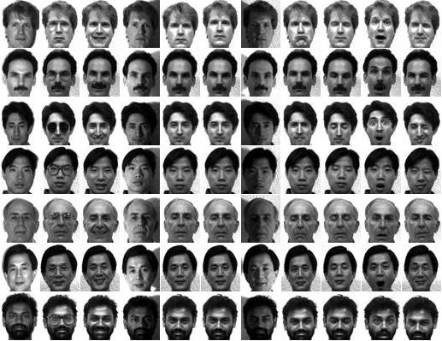

Slide 6
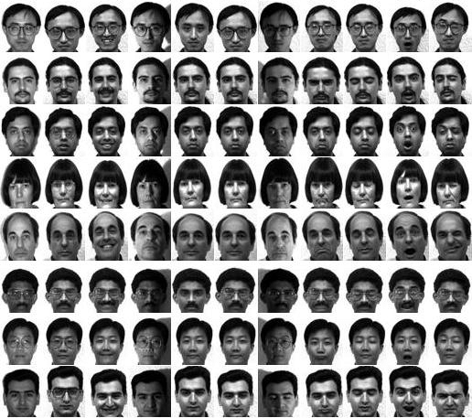

Slide 7
INPUT DATASET
HAAR CASCADE CLASSIFIER
DETECTEDED FACES
WITH ID
DETECTION:

Slide 8
HAAR FEATURE EXTRACTION
INTEGRAL IMAGE CREATION
ADABOOST
TRAINING
CASCADE CLASSIFIER
HAAR CASCADE CLASSIFIER

Slide 9
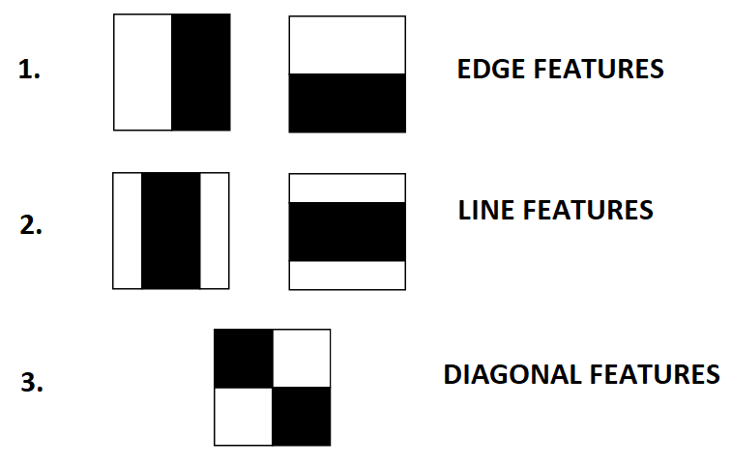
From training images features were extracted.

Slide 10
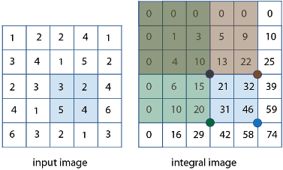
A feature was detected using Integral Image Algorithm.
The integral image at location (x , y) contains the sum of the pixels above and to the left of (x , y) inclusive.

Slide 11
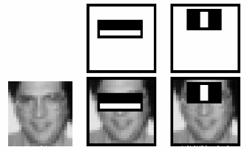
Adaboost algorithm then selected the haar features and train a weak classifier.

Slide 12
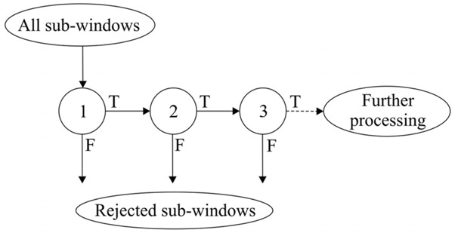
An image was passed through a series of classifiers to detect the face.

Slide 13
RECOGNITION
INPUT DETECTED FACES FOR TRAINING
LOCAL BINARY PATTERN HISTOGRAM
HISTOGRAM CREATED FOR EACH TRAINING IMAGE
LOCAL BINARY PATTERN HISTOGRAM
CALCULATE DISTANCE BETWEEN TRAINING AND TESTING HISTOGRAM
RETURN PREDICTED IMAGE WITH ID
HISTOGRAM CREATED FOR EACH TESTING IMAGE
INPUT TEST IMAGES

Slide 14
LOCAL BINARY PATTERN HISTOGRAM
The basic idea of Local Binary Patterns is to summarize the local structure in an image by comparing each pixel with its neighborhood.
STEP 1: We took part of an image as a 3x3 matrix containing the intensity of each pixel (0~255).
STEP 2: Then, we took the central pixel as threshold and if the intensity of the center pixel was greater or equal to its neighbor, then we denoted it with 1 and 0 if not.

Slide 15
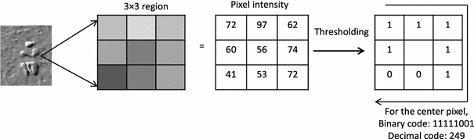
STEP 3: The resulting matrix contained only binary values. Then we concatenated a binary value from each position of the matrix and converted this binary value to a decimal value and set it to the central value of the matrix.

Slide 16
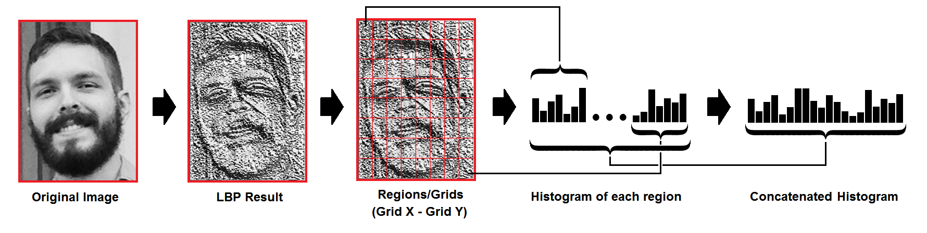
STEP 4: We performed the same procedure for all the pixels of the image and at the end, we had a new image which represents all the Linear Binary Codes.
STEP 5: We divided the resulting image into several regions and generated a histogram for each region.

Slide 17
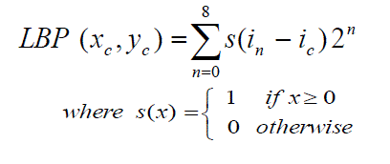
STEP 6: Then, we concatenated each histogram to create a new histogram which represents the characteristics of the original image.
A more formal description of the LBP operator can be given as:
With as central pixel with intensity and being the intensity of the the neighbor pixel and S is the sign function.

Slide 18
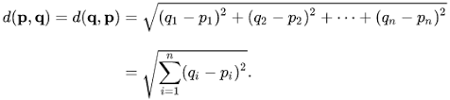
So, using the same steps we created a histogram for every image in the training dataset and for the input test image.
Then, we compared the histograms of test image with all the training images i.e. calculate the distance between two histograms. For that we have use Euclidean distance algorithm.
And the one with least distance was predicted.
Euclidean distance

Slide 19
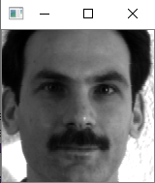
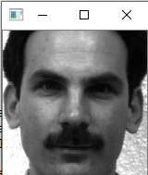
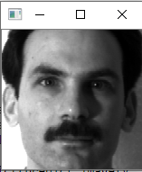
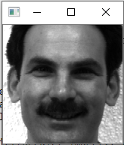
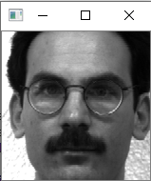
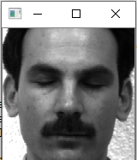
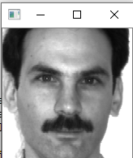
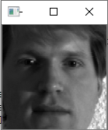
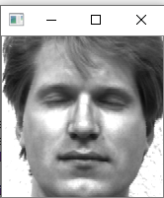
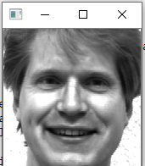
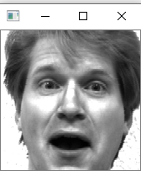
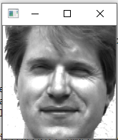
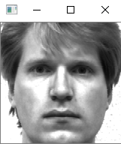
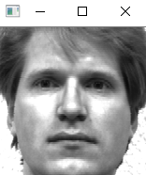
OUTPUT
Training Images

Slide 20
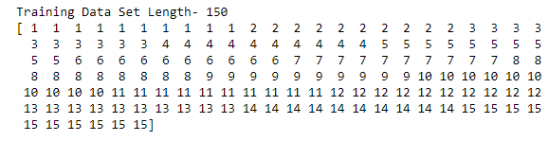
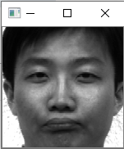
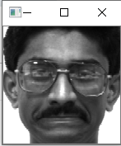
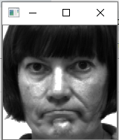
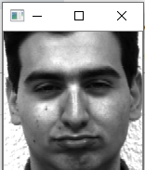
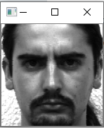
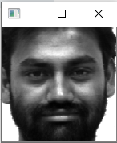
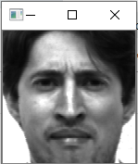
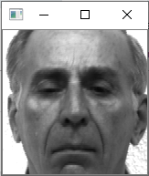
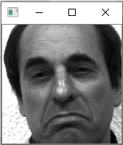
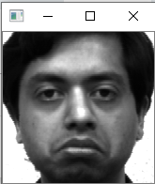
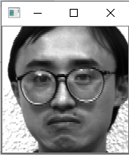
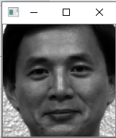
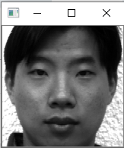
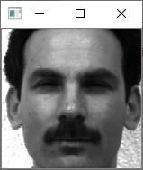
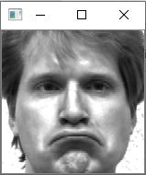
Testing Images

Slide 21
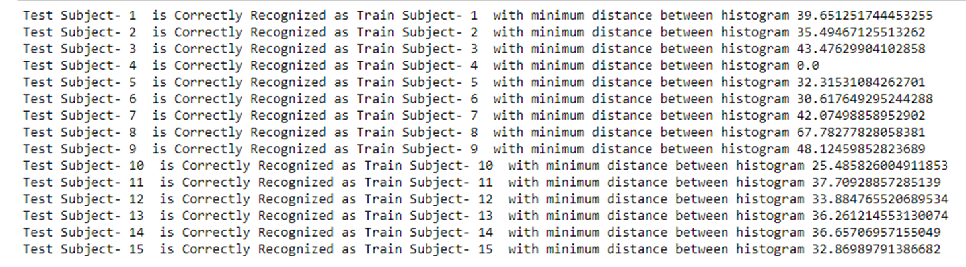
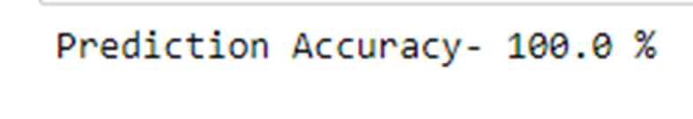
Prediction Result

Slide 22
LIMITATIONS
Our prediction model will not give such accuracy if pre-processed dataset is not used.
And if training and testing is done with 50% of the dataset.
Also, our model will not give such accuracy in real world cases, as testing and training is done on pre-processed data.
FUTURE WORKS
Other approaches with different algorithms like Eigenfaces and Fisherfaces can be done for better accuracy over comparatively larger datasets.

Slide 23

References
Sudha Narang, Kriti Jain, Megha Saxena, Aashna Arora, “Comparison of Face Recognition Algorithms Using Opencv for Attendance System” in International Journal of Scientific and Research Publications, Volume 8, Issue 2, February 2018.
Md. Abdur Rahim, Md. Najmul Hossain, Tanzillah Wahid & Md. Shafiul Azam, “Face Recognition using Local Binary Patterns (LBP)” in Global Journal of Computer Science and Technology Graphics & Vision Volume 13 Issue 4 Version 1.0 Year 2013.
Paul Viola, Michael Jones, “Rapid Object Detection using a Boosted Cascade of Simple Features” at Accepted Conference On Computer Vision And Pattern Recognition 2001.

Slide 24
References
Dataset- http://cvc.cs.yale.edu/cvc/projects/yalefaces/yalefaces.html
https://towardsdatascience.com/face-recognition-how-lbph-works-90ec258c3d6b
Documentation-https://docs.opencv.org/2.4/modules/contrib/doc/facerec/facerec_tutorial.html?highlight=local%20binary%20pattern%20histogram#face-database
Video Lecture- https://www.youtube.com/watch?v=wpAwdsubl1w
https://www.youtube.com/watch?v=uEJ71VlUmMQ

Slide 25


